Slide 1
Mehran S. Fallah April 2020
Discrete Mathematics
Session VII
An Introduction to Logic

Slide 2
Introduction
Today, logic is a branch of mathematics and a branch of philosophy. In most large universities, both departments offer courses in logic, and there is usually a lot of overlap between them.
Formal languages, deductive systems, and model-theoretic semantics are mathematical objects and, as such, the logician is interested in their mathematical properties and relations. Soundness and completeness are typical examples.
Philosophically, logic is at least closely related to the study of correct reasoning. Reasoning is an epistemic, mental activity. So logic is at least closely allied with epistemology.
Logic is also a central branch of computer science, due, in part, to interesting computational relations in logical systems, and, in part, to the close connection between formal deductive argumentation and reasoning.
Typically, a logic consists of a formal or informal language together with a deductive system and/or a model-theoretic semantics.
The language has components that correspond to a part of a natural language like English, Greek, or Persian. The deductive system is to capture, codify, or simply record arguments that are valid for the given language, and the semantics is to capture, codify, or record the meanings, or truth-conditions for at least part of the language.

Slide 3
Introduction (Ctd.)
Typically, ordinary deductive reasoning takes place in a natural language, or perhaps a natural language augmented with some mathematical symbols. So our question begins with the relationship between a natural language and a formal language.
One view is that the formal languages accurately exhibit actual features of certain fragments of a natural language.
Another view is that a formal language is a mathematical model of a natural language in roughly the same sense as, say, a collection of point masses is a model of a system of physical objects, and the Bohr construction is a model of an atom.
In other words, a formal language displays certain features of natural languages, or idealizations thereof, while ignoring or simplifying other features.
On a view like this, deducibility and validity represent mathematical models of (perhaps different aspects of) correct reasoning in natural languages.
Symbolic logic, the study of symbolic abstractions that capture the formal features of logical inference, is an example of formal logic. Symbolic logic is often divided into two main branches: propositional logic and predicate logic (first-order logic).

Slide 4
Introduction (Ctd.)
Symbolic logic is a mathematical model of deductive thought. It is a model in much the same way that modern probability theory is a model for situations involving chance and uncertainty.
How are models constructed? You begin with a real-life object, for example an airplane. Then you select some features of this original object to be represented in the model, for example its shape, and others to be ignored, for example its size.
The real-life objects in logic are certain “logically correct” deductions. For example,
All men are mortal.
Socrates is a man.
Therefore, Socrates is mortal.
The validity of inferring the third sentence (the conclusion) from the first two (the assumptions) does not depend on special idiosyncrasies of Socrates. The inference is justified by the form of the sentences rather than by empirical facts about mortality. It is not really important here what “mortal” means; it does matter what “all” means.
Borogoves are mimsy whenever it is brillig.
It is now brillig, and this thing is a borogove.
Hence, this thing is mimsy.
Again we can recognize that the third sentence follows from the first two, even without the slightest idea of what a mimsy borogove might look like.

Slide 5
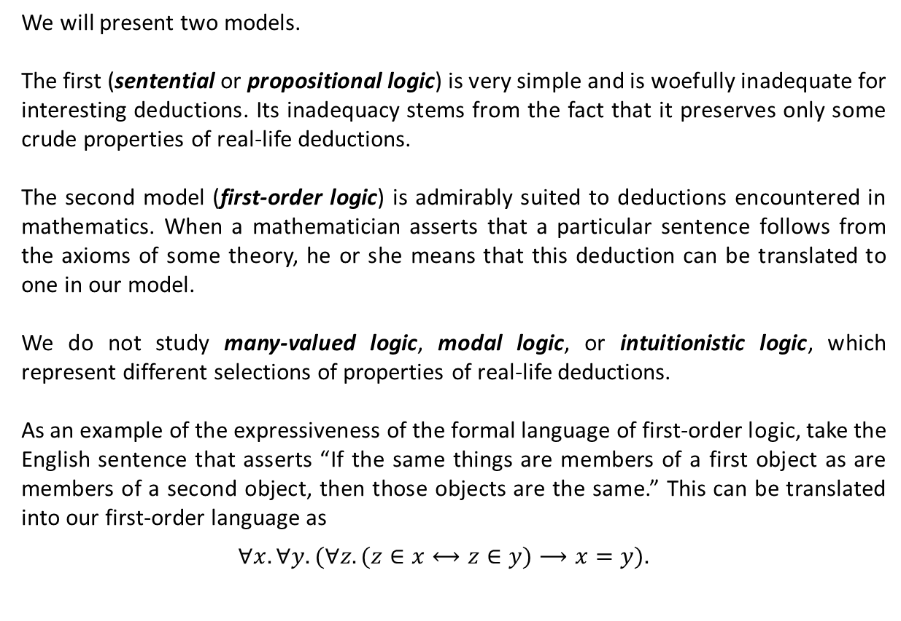
Introduction (Ctd.)
We will present two models.
The first (sentential or propositional logic) is very simple and is woefully inadequate for interesting deductions. Its inadequacy stems from the fact that it preserves only some crude properties of real-life deductions.
The second model (first-order logic) is admirably suited to deductions encountered in mathematics. When a mathematician asserts that a particular sentence follows from the axioms of some theory, he or she means that this deduction can be translated to one in our model.
We do not study many-valued logic, modal logic, or intuitionistic logic, which represent different selections of properties of real-life deductions.
As an example of the expressiveness of the formal language of first-order logic, take the English sentence that asserts “If the same things are members of a first object as are members of a second object, then those objects are the same.” This can be translated into our first-order language as
$$∀x. ∀y.(∀z. (z∈x⟷z∈y)⟶x=y).$$

Slide 6
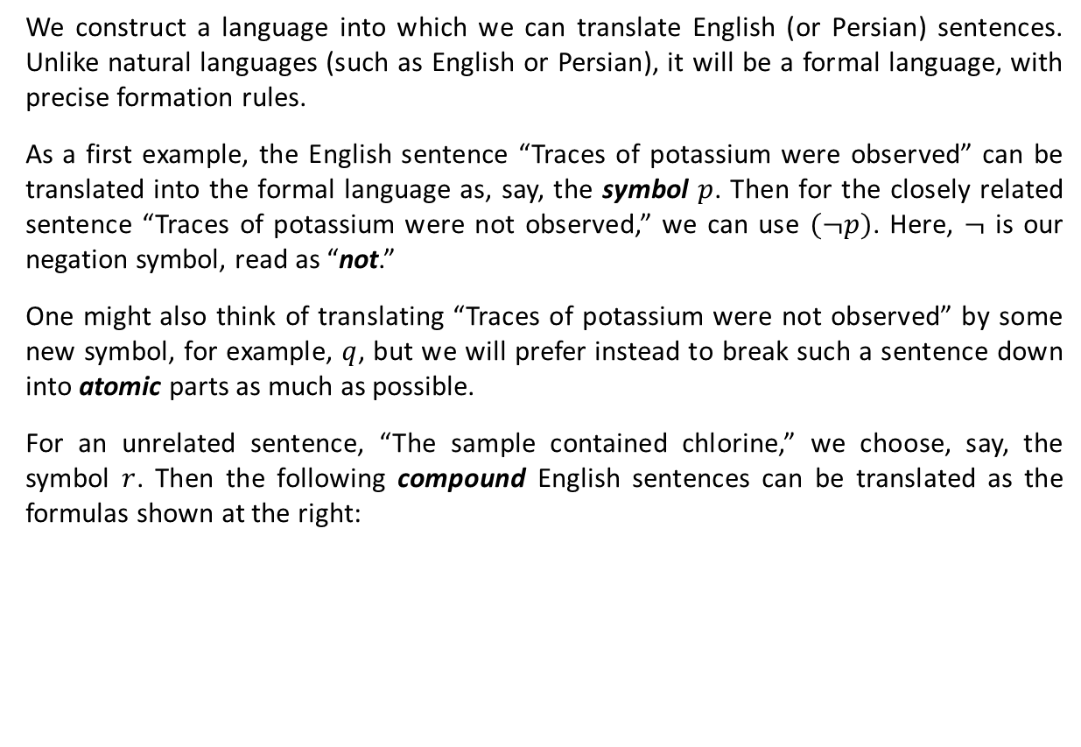
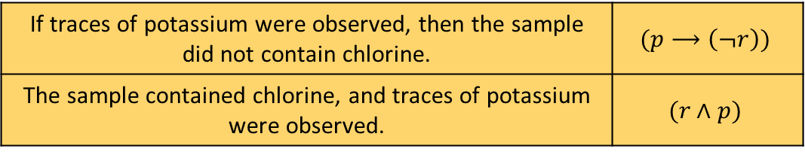
Propositional Logic
We construct a language into which we can translate English (or Persian) sentences. Unlike natural languages (such as English or Persian), it will be a formal language, with precise formation rules.
As a first example, the English sentence “Traces of potassium were observed” can be translated into the formal language as, say, the symbol $p$. Then for the closely related sentence “Traces of potassium were not observed,” we can use $(¬p)$. Here, $¬$ is our negation symbol, read as “not.”
One might also think of translating “Traces of potassium were not observed” by some new symbol, for example, $q$, but we will prefer instead to break such a sentence down into atomic parts as much as possible.
For an unrelated sentence, “The sample contained chlorine,” we choose, say, the symbol $r$. Then the following compound English sentences can be translated as the formulas shown at the right:
If traces of potassium were observed, then the sample did not contain chlorine. | $$(p⟶\left(¬r\right))$$
The sample contained chlorine, and traces of potassium were observed. | $$(r∧p)$$

Slide 7

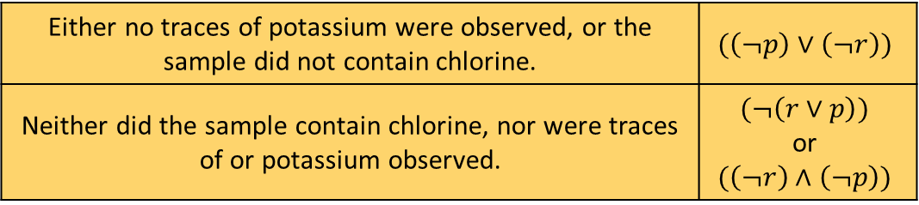

Propositional Logic (Ctd.)
The second case uses our conjunction symbol $∧$ to translate “and.” The first one uses the more familiar arrow to translate “if ... , then ... .”
In the following example the disjunction symbol $∨$ is used to translate “or”:
For this last sentence, we have two alternative translations. The relationship between them will be discussed later. It is a topic related to the meaning of sentences (semantics of the language.)
Now, we give a formal definition of the syntax of the language of propositional logic.
If traces of potassium were observed, then the sample did not contain chlorine. | $$(p⟶\left(¬r\right))$$
The sample contained chlorine, and traces of potassium were observed. | $$(r∧p)$$
Either no traces of potassium were observed, or the sample did not contain chlorine. | $$(\left(¬p\right)∨\left(¬r\right))$$
Neither did the sample contain chlorine, nor were traces of or potassium observed. | $$(¬\left(r∨p\right))$$ or $$(\left(¬r\right)∧\left(¬p\right))$$

Slide 8
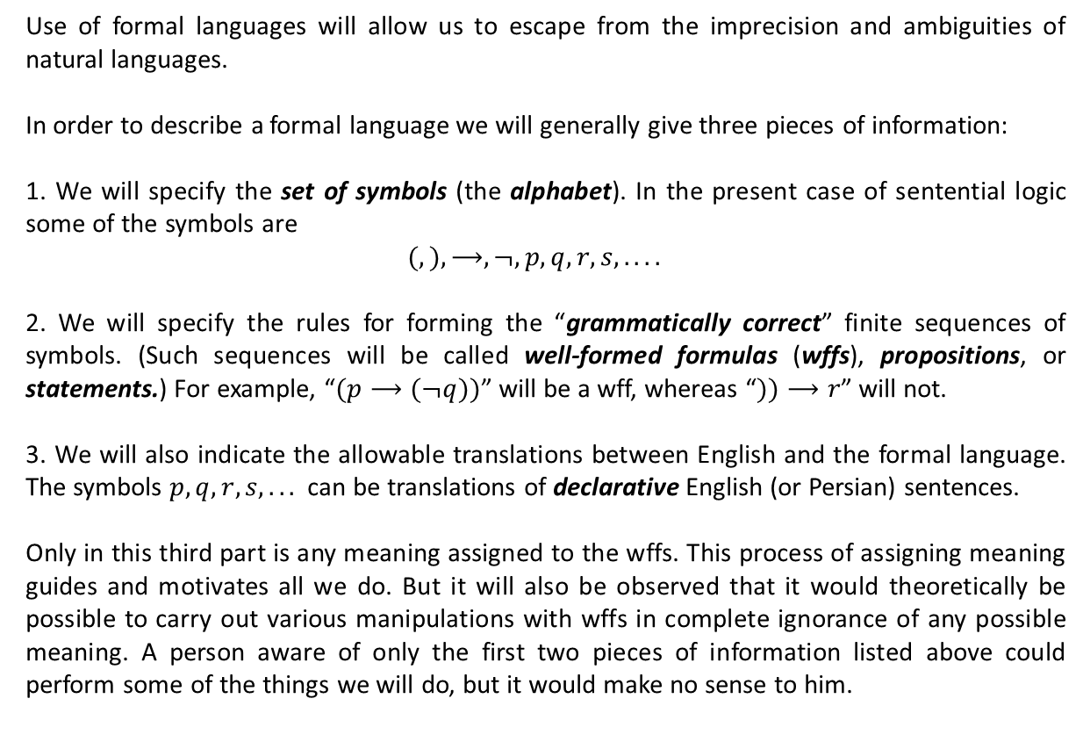
Syntax: Well-Formed Formula of the Logic
Use of formal languages will allow us to escape from the imprecision and ambiguities of natural languages.
In order to describe a formal language we will generally give three pieces of information:
1. We will specify the set of symbols (the alphabet). In the present case of sentential logic some of the symbols are
$$(, ),⟶,¬,p,q, r, s, . . . .$$
2. We will specify the rules for forming the “grammatically correct” finite sequences of symbols. (Such sequences will be called well-formed formulas (wffs), propositions, or statements.) For example, “$(p⟶(¬q))$” will be a wff, whereas “$))⟶r$” will not.
3. We will also indicate the allowable translations between English and the formal language. The symbols $p, q, r, s, . . .$ can be translations of declarative English (or Persian) sentences.
Only in this third part is any meaning assigned to the wffs. This process of assigning meaning guides and motivates all we do. But it will also be observed that it would theoretically be possible to carry out various manipulations with wffs in complete ignorance of any possible meaning. A person aware of only the first two pieces of information listed above could perform some of the things we will do, but it would make no sense to him.

Slide 9
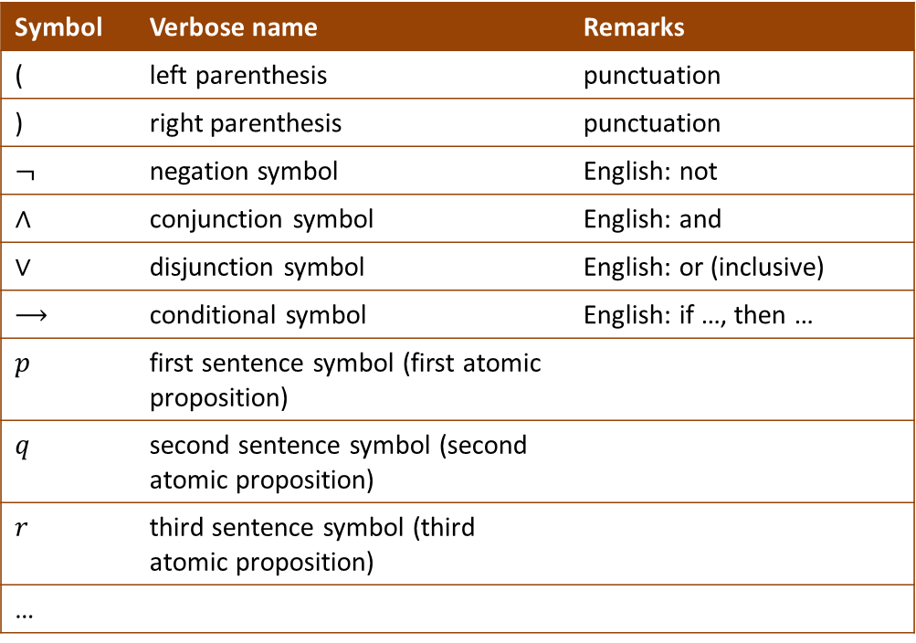
Syntax: Well-Formed Formula of the Logic
We assume we are given an infinite sequence of distinct objects which we will call symbols, and to which we now give names (the following table). We further assume that no one of these symbols is a finite sequence of other symbols.
Symbol | Verbose name | Remarks
( | left parenthesis | punctuation
) | right parenthesis | punctuation
$$¬$$ | negation symbol | English: not
$$∧$$ | conjunction symbol | English: and
$$∨$$ | disjunction symbol | English: or (inclusive)
$$⟶$$ | conditional symbol | English: if …, then …
$$p$$ | first sentence symbol (first atomic proposition)
$$q$$ | second sentence symbol (second atomic proposition)
$$r$$ | third sentence symbol (third atomic proposition)
…

Slide 10
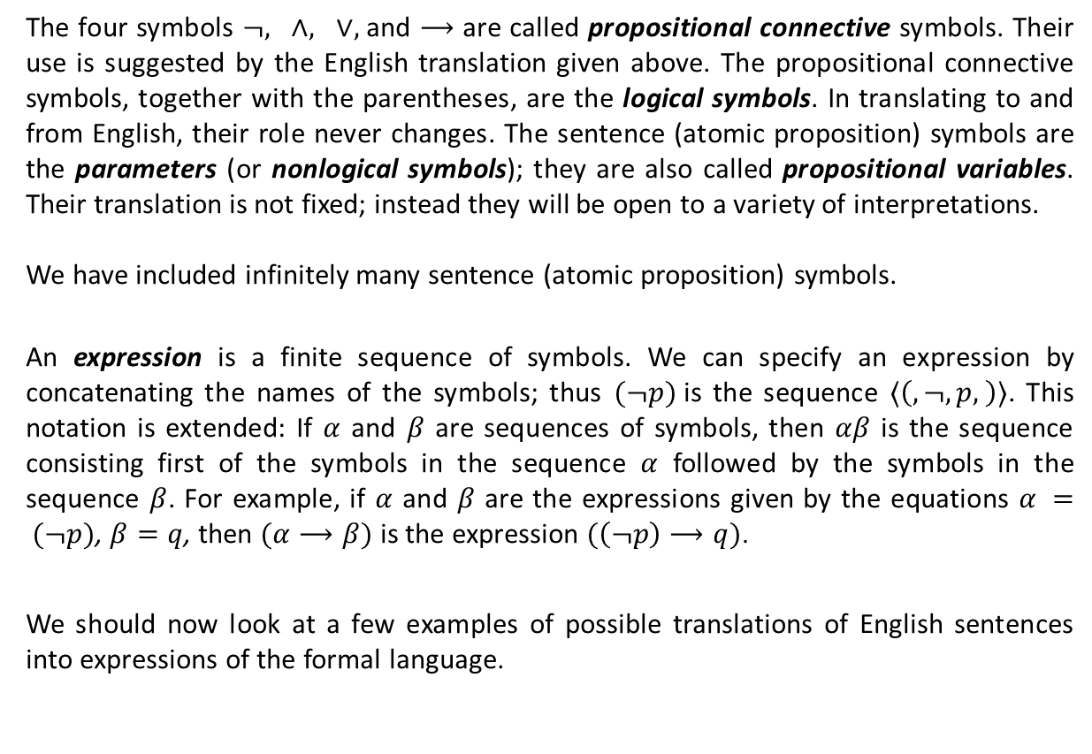
Syntax: Well-Formed Formula of the Logic
The four symbols $¬, ∧, ∨,$and $⟶$ are called propositional connective symbols. Their use is suggested by the English translation given above. The propositional connective symbols, together with the parentheses, are the logical symbols. In translating to and from English, their role never changes. The sentence (atomic proposition) symbols are the parameters (or nonlogical symbols); they are also called propositional variables. Their translation is not fixed; instead they will be open to a variety of interpretations.
We have included infinitely many sentence (atomic proposition) symbols.
An expression is a finite sequence of symbols. We can specify an expression by concatenating the names of the symbols; thus $(¬p)$is the sequence $〈\left(,¬,p, \right)〉$. This notation is extended: If $α$ and $β$ are sequences of symbols, then $αβ$ is the sequence consisting first of the symbols in the sequence $α$ followed by the symbols in the sequence $β$. For example, if $α$ and $β$ are the expressions given by the equations $α = (¬p)$, $β=q$, then $(α⟶β)$ is the expression $(\left(¬p\right)⟶q)$.
We should now look at a few examples of possible translations of English sentences into expressions of the formal language.

Slide 11

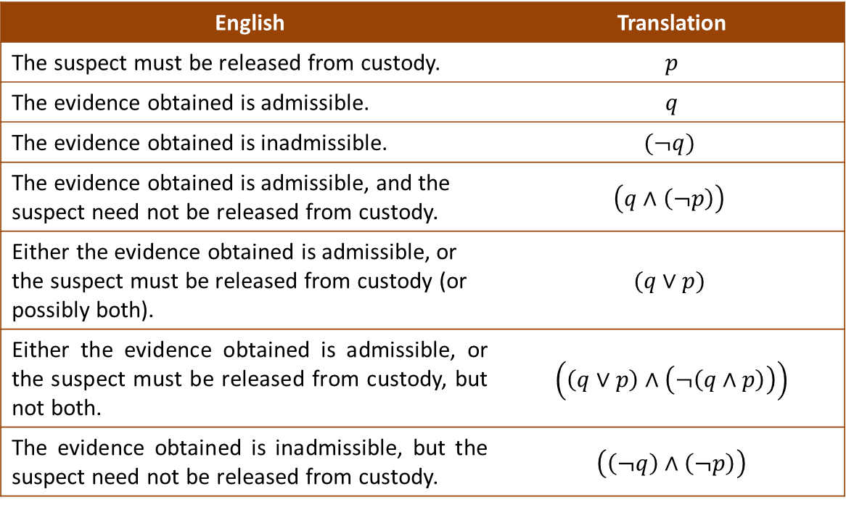
Syntax (Ctd.)
Let $p$ and $q$ be the first two sentence symbols (atomic proposition symbols.)
English | Translation
The suspect must be released from custody. | $$p$$
The evidence obtained is admissible. | $$q$$
The evidence obtained is inadmissible. | $$(¬q)$$
The evidence obtained is admissible, and the suspect need not be released from custody. | $$\left(q∧\left(¬p\right)\right)$$
Either the evidence obtained is admissible, or the suspect must be released from custody (or possibly both). | $$(q∨p)$$
Either the evidence obtained is admissible, or the suspect must be released from custody, but not both. | $\left(\left(q∨p\right)∧\left(¬\left(q∧p\right)\right)\right)$
The evidence obtained is inadmissible, but the suspect need not be released from custody. | $\left(\left(¬q\right)∧\left(¬p\right)\right)$

Slide 12



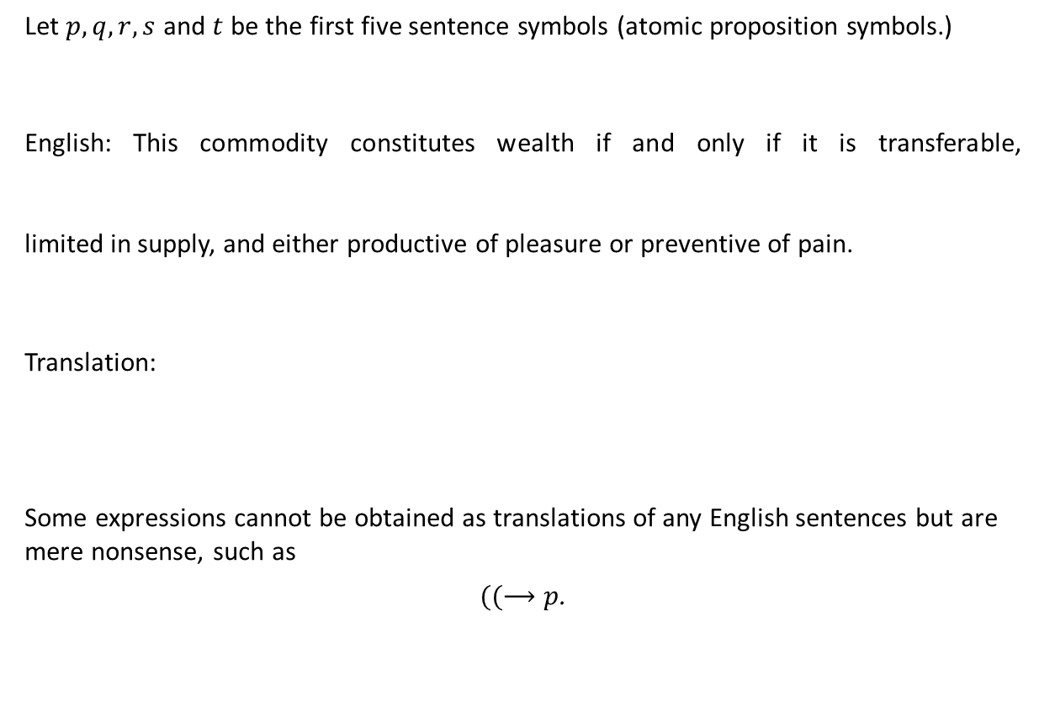





Syntax (Ctd.)
Let $p, q, r, s$ and $t$ be the first five sentence symbols (atomic proposition symbols.)
English: This commodity constitutes wealth if and only if it is transferable, limited in supply, and either productive of pleasure or preventive of pain.
Translation:
Some expressions cannot be obtained as translations of any English sentences but are mere nonsense, such as
$((⟶p$.
$$p$$
$$q$$
$$r$$
$$s$$
$$t$$
$$\left(\left(q∧\left(r∧\left(s∨t\right)\right)\right)⟶p\right)$$
$$∧$$
$$\left(p⟶\left(q∧\left(r∧\left(s∨t\right)\right)\right)\right)$$

Slide 13
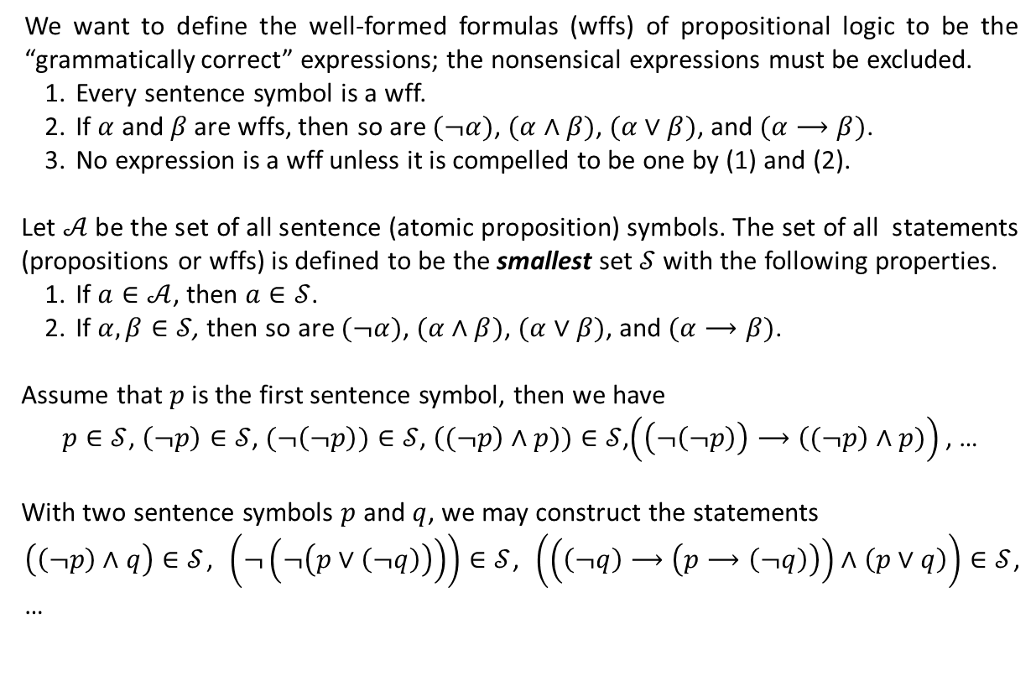
Syntax (Ctd.)
We want to define the well-formed formulas (wffs) of propositional logic to be the “grammatically correct” expressions; the nonsensical expressions must be excluded.
Every sentence symbol is a wff.
If $α$ and $β$ are wffs, then so are $(¬α)$, $(α∧β)$, $(α∨β)$, and $(α⟶β)$.
No expression is a wff unless it is compelled to be one by (1) and (2).
Let $𝒜$ be the set of all sentence (atomic proposition) symbols. The set of all statements (propositions or wffs) is defined to be the smallest set $𝒮$with the following properties.
If $a∈𝒜$, then $a∈𝒮$.
If $α,β∈𝒮$, then so are $(¬α)$, $(α∧β)$, $(α∨β)$, and $(α⟶β)$.
Assume that $p$ is the first sentence symbol, then we have
$p∈𝒮$, $\left(¬p\right)∈𝒮$, $(¬\left(¬p\right))∈𝒮$, $\left((¬p\right)∧p))∈𝒮$,$\left(\left(¬\left(¬p\right)\right)⟶\left((¬p\right)∧p)\right)$, …
With two sentence symbols $p$ and $q$, we may construct the statements
$\left(\left(¬p\right)∧q\right)∈𝒮$, $\left(¬\left(¬\left(p∨\left(¬q\right)\right)\right)\right)∈𝒮$, $\left(\left(\left(¬q\right)⟶\left(p⟶\left(¬q\right)\right)\right)∧\left(p∨q\right)\right)∈𝒮$, …

Slide 14





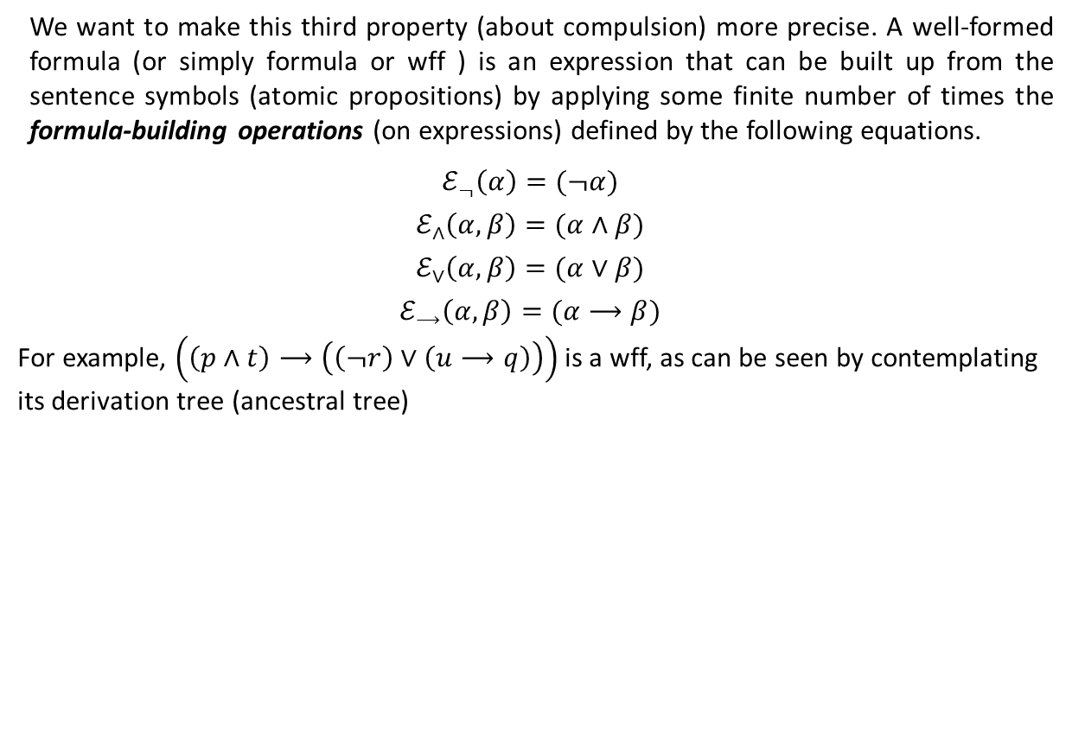













Syntax (Ctd.)
We want to make this third property (about compulsion) more precise. A well-formed formula (or simply formula or wff ) is an expression that can be built up from the sentence symbols (atomic propositions) by applying some finite number of times the formula-building operations (on expressions) defined by the following equations.
$$ℰ_{¬}\left(α\right)=(¬α)$$
$$ℰ_{∧}\left(α,β\right)=(α∧β)$$
$$ℰ_{∨}\left(α,β\right)=(α∨β)$$
$$ℰ_{⟶}\left(α,β\right)=(α⟶β)$$
For example, $\left(\left(p∧t\right)⟶\left(\left(¬r\right)∨\left(u⟶q\right)\right)\right)$ is a wff, as can be seen by contemplating its derivation tree (ancestral tree)
$$r$$
$$u$$
$$q$$
$$\left(\left(p∧t\right)⟶\left(\left(¬r\right)∨\left(u⟶q\right)\right)\right)$$
$$p$$
$$t$$
$$(¬r)$$
$$(u⟶q)$$
$$(p∧t)$$
$$\left(\left(¬r\right)∨\left(u⟶q\right)\right)$$
$$(p∧t)$$
$$\left(\left(¬r\right)∨\left(u⟶q\right)\right)$$
$$p$$
$$t$$
$$(¬r)$$
$$(u⟶q)$$
$$\left(\left(p∧t\right)⟶\left(\left(¬r\right)∨\left(u⟶q\right)\right)\right)$$
$$r$$
$$u$$
$$q$$

Slide 15
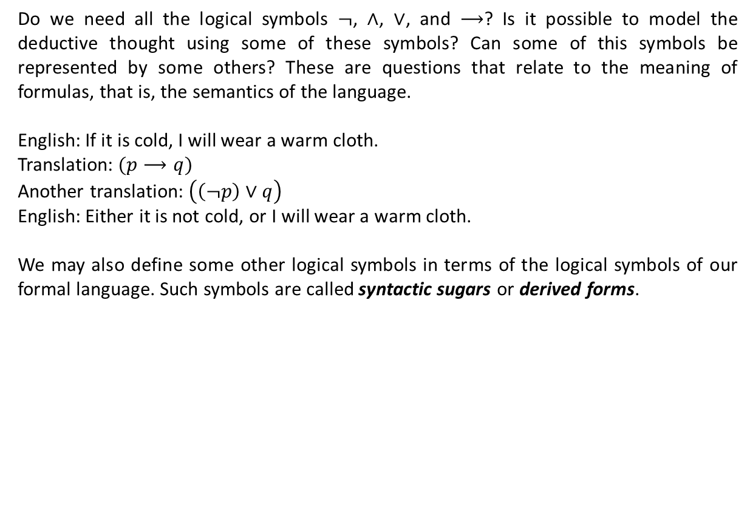
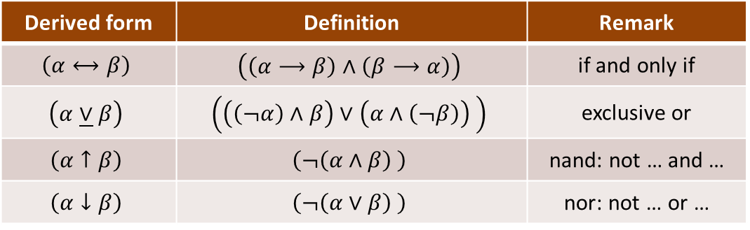
Syntactic Sugars (Derived Forms)
Do we need all the logical symbols $¬$, $∧$, $∨$, and $⟶$? Is it possible to model the deductive thought using some of these symbols? Can some of this symbols be represented by some others? These are questions that relate to the meaning of formulas, that is, the semantics of the language.
English: If it is cold, I will wear a warm cloth.
Translation: $(p⟶q)$
Another translation: $\left(\left(¬p\right)∨q\right)$
English: Either it is not cold, or I will wear a warm cloth.
We may also define some other logical symbols in terms of the logical symbols of our formal language. Such symbols are called syntactic sugars or derived forms.
Derived form | Definition | Remark
$$\left(α⟷β\right)$$ | $$\left(\left(α⟶β\right)∧\left(β⟶α\right)\right)$$ | if and only if
$$\left(α\underline{∨}β\right)$$ | $$\left(\left(\left(¬α\right)∧β\right)∨\left(α∧\left(¬β\right)\right) \right)$$ | exclusive or
$$\left(α↑β\right)$$ | $$\left(¬\left(α∧β\right) \right)$$ | nand: not … and …
$$\left(α↓β\right)$$ | $$\left(¬\left(α∨β\right) \right)$$ | nor: not … or …

Slide 16

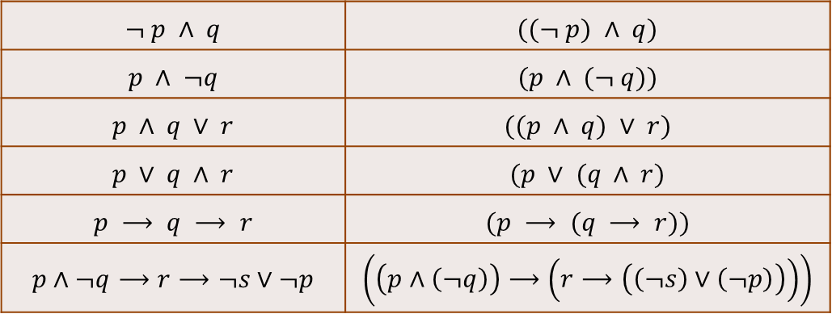
Some Other Variants of the Language
We may give priority (a higher precedence) to a logical symbol (logical operator) over some others. This may help us omit (drop) some parentheses from the formulas of the logic.
The logical symbol $¬$ has higher precedence than $∧$; ∧ has higher precedence than $∨$; and $∨$ has higher precedence than $⟶$. The logical symbol $⟶$ also associates to right.
We may also add two constants $⊤$ (top), written $T_{0}$ in your textbook, and $⊥$ (bot), written $F_{0}$ in your textbook, to our language. They represent the verum (logically true) and the falsum (logically false), respectively.
$$¬ p ∧ q$$ | $$((¬ p) ∧ q)$$
$$p ∧ ¬q$$ | $$(p ∧ (¬ q))$$
$$p ∧ q ∨ r$$ | $$((p ∧ q) ∨ r)$$
$$p ∨ q ∧ r$$ | $$(p ∨ (q ∧ r)$$
$$p ⟶ q ⟶ r$$ | $$(p ⟶ (q ⟶ r))$$
$$p∧¬q⟶r⟶¬s∨¬p$$ | $$\left(\left(p∧\left(¬q\right)\right)⟶\left(r⟶\left(\left(¬s\right)∨\left(¬p\right)\right)\right)\right)$$

Slide 17
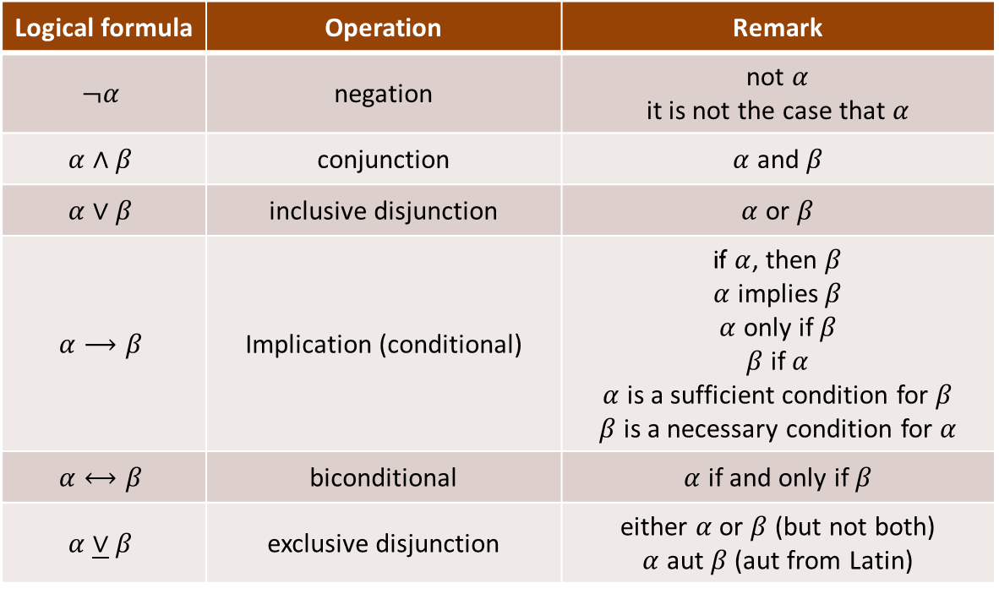
A Summary of Logical Symbols
Logical formula | Operation | Remark
$$¬α$$ | negation | not $α$ it is not the case that $α$
$$α∧β$$ | conjunction | $α$ and $β$
$$α∨β$$ | inclusive disjunction | $α$ or $β$
$$α⟶β$$ | Implication (conditional) | if $α$, then $β$ $α$ implies $β$ $α$ only if $β$ $β$ if $α$ $α$ is a sufficient condition for $β$ $β$ is a necessary condition for $α$
$$α⟷β$$ | biconditional | $α$ if and only if $β$
$$α\underline{∨}β$$ | exclusive disjunction | either $α$ or $β$ (but not both) $α$ aut $β$ (aut from Latin)

Slide 18
Textbook: Ralph P. Grimaldi, Discrete and Combinatorial Mathematics
You may also consult with other books about mathematical logic.

